Slide 1
Data Breaches Happening in the United States
DATS 6401 - Data Visualization-Individual Project 2
TejaswiniVuppu

Slide 2
Overview of Data
Data was taken from the Privacy Rights Clearinghouse.
Charts used to display are Stack charts, Bar Charts, Column charts and Pie charts.
Years of data range from 2009 to 2014.
Initially, data was taken in CSV format.
Later it was Cleaned using Python(Jupyter notebook sheet) and Excel.
Choose all the states of united states concerning data breach attacks.Java Script, HTML, Bootstrap and Google API are used for the visualization process.

Slide 3
Goals
Finding the Type of breach based on the company.
Comparing the total number of breaches happening concerning the year.
Determining the breach count based on its type.
Finding the correlation between all the variables in the dataset.
Finding the highest number of breaches based on the Year.
Plotting the geo maps to determine which state has the number of breaches.

Slide 4
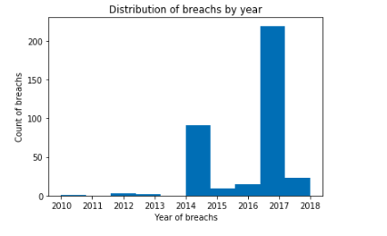
Comparing the total number of breaches happening concerning the year.

Slide 5
Comparing the total number of breaches happening concerning the year.(Continuation)
In the above slide, I have displayed the histogram, by plotting the Year of the breach in the x-axis and count of attacks on the y-axis.
And I have represented it, naming the distribution of breaches by year.
When I look at the histogram, 2017 is the year where hackers are mostly concentrated.
In that year, i see the highest breach count.
Until 2013, I do not see so many data breach happening, but it started increasing from 2014.
And the state becomes vice versa every year, but I see the increased state from 2014.

Slide 6
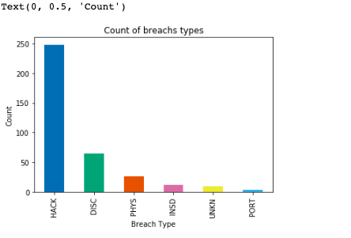
Determining the count of Type of breach.

Slide 7
Determining the count of Type of breach.(Continuation)
In the above slide, I have displayed the barplot by plotting the Breach Type in the x-axis and count of it on the y-axis.
And I have represented it naming the count of breach types.
When I look at barplot HACK is a breach which is topmost breach type where most hackers use it.
Rest second and third positions are covered by DISC and PHYS.In this barplot, i see the most prominent data breach type.
HACK is breach type with a count of 250.
Remaining all having the count below 100.
So, if companies attacked by this type of breach, will be careful this problem may be eradicated.
Other companies also should know more about this type of breach and know the ways to stop attacked by this type of breach.

Slide 8
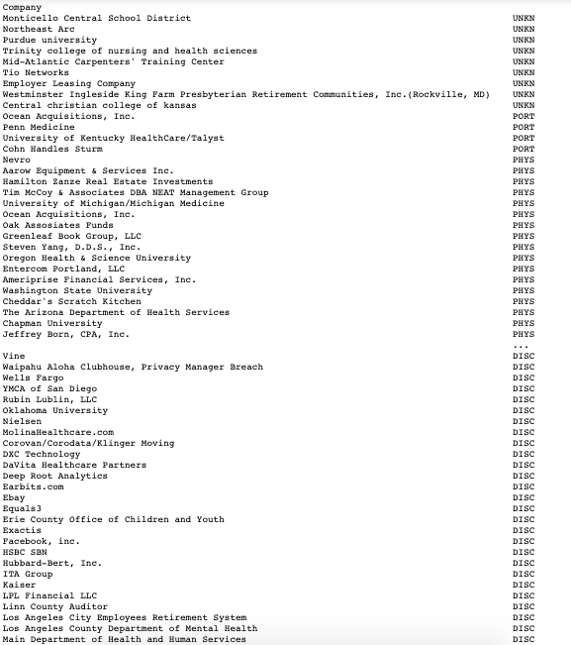
Finding the Type of breach based on the company.

Slide 9
Finding the Type of breach based on the company.(Continuation)
In the above slide, I have displayed the type of breach based on company data.
I have used group by function in the syntax to get data of both the columns.
If I don't have exact information or proof that which type of breach attacked this company we can keep that type of breach as "UNKNOWN" and it is represented as "UNKN" in the dataset.
Based on this data we can get to know hackers are concentrating on which type of breach and which domain type of companies they are looking for.

Slide 10
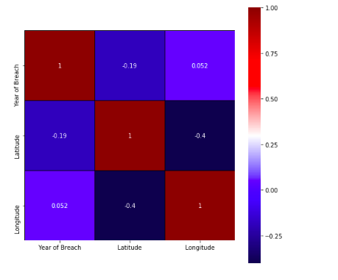
Finding the correlation between all the variables in the dataset

Slide 11
Finding the correlation between all the variables in the dataset
(Continuation)
In the above slide, we can see the correlation between only 3 variables among all the variables in the dataset.
Latitude, Longitude and Year of Breach are highly correlated.
Correlation helps us to know the relation between the variables in the dataset.
If there is no relation between the variables figures are not displayed when we run the syntax.
There are types in correlation based on our data like Weak or Strong correlation, positive or negative correlation.

Slide 12
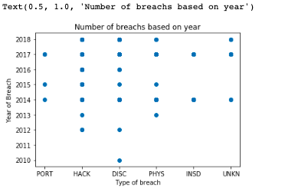
Finding the highest number of breaches based on the Year.

Slide 13
Finding the highest number of breaches based on the Year.(Continuation)
In the above slide, I plotted the scatter plot by taking the combination of two columns Type of breach and Year of Breach columns to check which year covers all type of breaches.
And check which type pf breach happens in almost all years.
I have taken Type of breach on x-axis and Year of Breach on the y-axis.
2014 is the year which is attacked by all types of breaches based on the data given. According to my assumption, 2014 is the year where most hackers have used all breach types to start attacking process.
When I look at the scatter plot I got to know one more thing where HACK and DISC breach types are two types of breaches which are highly affecting.

Slide 14
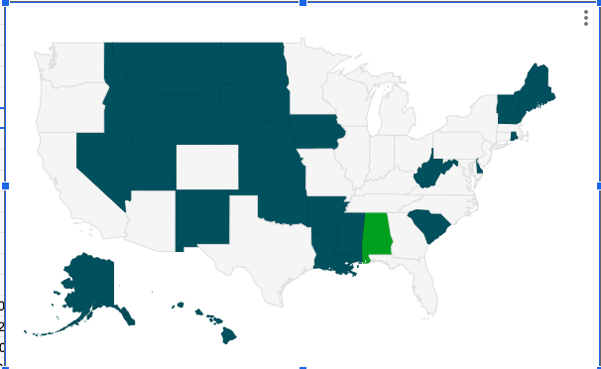
Plotting the geo maps to determine which state has the number of breaches

Slide 15
Plotting the geo maps to determine which state has the number of breaches(Continuation)
In the above slide, I plotted the geo maps by taking the State column data and combining it with the total number of records.
And now I got to know which State has the highest number of records saying that this state is most commonly affected with the data breaches.
Based on this information also I got to know which state should protect the data from the hackers. I got to know how many times each state is affected.

Slide 16
Conclusion
In this project, I dealt with different types of breaches and tell people who are worried about it.
These are areas, which are to be improved and vendors, be able to see which is the most important breach, happening frequently.
By using the 'Description of Incident' column, we can eradicate the attacks which are coming in future by using some methodologies.
I conclude saying that factors to protect the company from data breaches are giving limited access to secure database which is Information source in this dataset and keeping passwords which are quite lengthy for these type of databases.

